Slide 1
Networking 101: How to Make “Networking” Work Better and Suck Less

Slide 2
Show of hands?

Slide 3
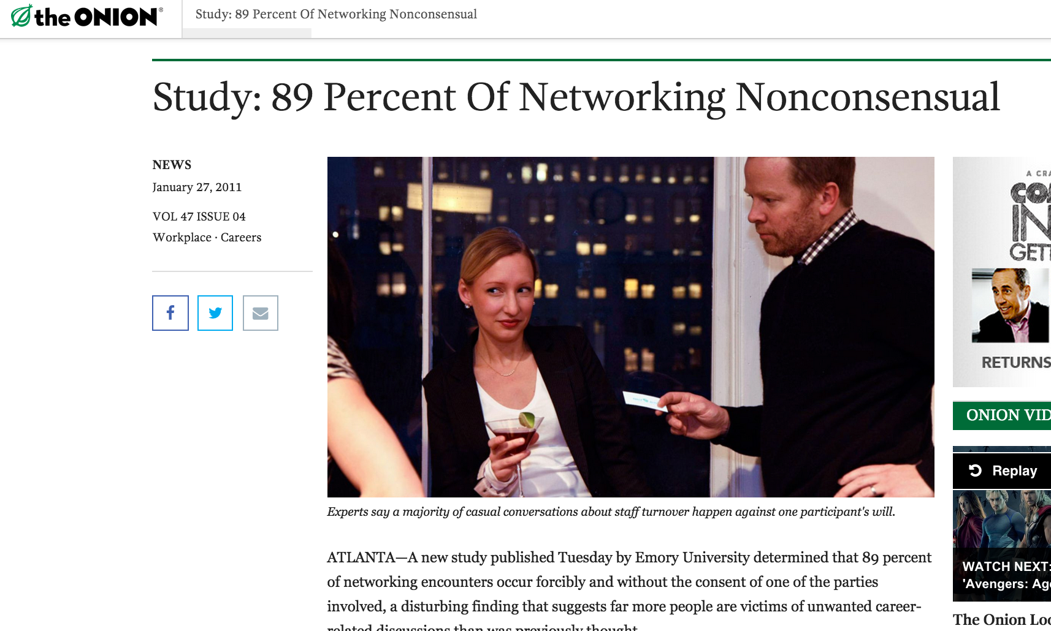

Slide 4
Why Bother?
It’s easier to get stuff done with a network.
Because you are not going to have one job for the rest of your life.

Slide 5
People are different.
Pure Torture
Second Nature
“This is impossible and makes me incredibly anxious. I can’t believe you’re telling me I have to go talk to strangers. I want to be a dev so I don’t have to do that…”
“This is so easy. I don’t even understand why we’re doing a workshop on this. You’re basically telling us to be nice and make conversation.”

Slide 6
Pick a lens.
Networking?
Community-building?
Knowledge-sharing?
Take what works. Leave the rest.

Slide 7
Story Digression

Slide 8
1. Long Game. 2. Give>Take.

Slide 9

“People come to Silicon Valley to make money and engage in transactions, rather than to build relationships. His goal is not to optimize the economic value of any given relationship, but to meet smart, interesting people. If it provides value to him in the long run, that’s a lucky circumstance.”
Tristan Walker
Founder, Walker & Co

Slide 10

“Don’t always look for the ‘most important person’ in the room and try to get them to take an interest in you. Look to your peers. Find some people who share your struggles and ambitions and values and help each other out. Make something cool together, even. And don’t be afraid, when you see something you really like, to just send an email and thank the person who made it.”
Ann Friedman
Journalist/podcaster

Slide 11
Step 1: Go to Events

Slide 12
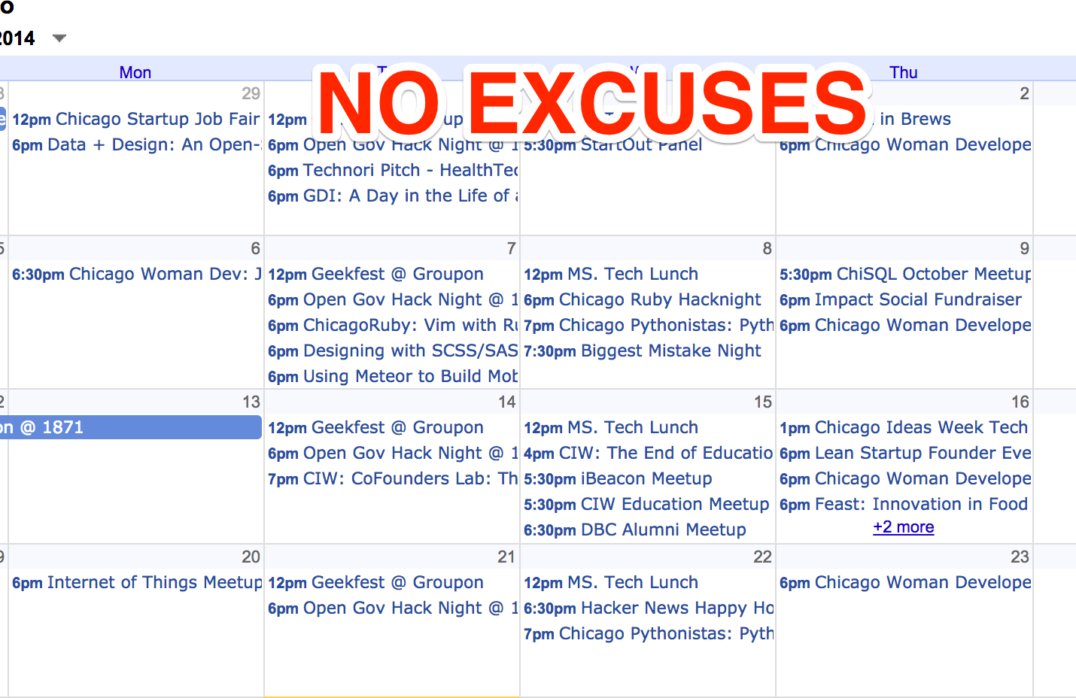
Don’t pay for anything.

Slide 13
So many events, so little time.
Information + Mingling
Guest list
Reverse-engineer it.
Think outside the box.

Slide 14

Step 2: Talk to People

Slide 15


Wingman or Build a Safety Island

Slide 16
Tips:
“What did you think of the presentation?”
“What are you working on?”
3:1 Ratio
Goal = 3 conversations
“Hey, could I get your card? I’d love to follow up with you about X.” [Biz Cards?]

Slide 17





Know Your Industry

Slide 18

Step 3: Follow up

Slide 19
2. Give>Take

Slide 20

Give.
Give.
Give.
Ask.

Slide 21


Slide 22
What do you have to offer?
Thank you
Congratulations
Recommendation (Restaurant? App? TV show? Book?)
Social media support (Tweet? Photo? FB post?)
Review/testimonial/feedback
Hiring referral (Doesn’t have to be tech, doesn’t have to be you)
Volunteering/mentorship
Introduction
Event invitation
Article
Tour
Expertise from your past life

Slide 23



Match mediums. Keep it short.

Slide 24
Step 4: Now you have a network, use it

Slide 25

Do favors.*
*2 minutes or less = Yes.
*3-15 minutes = Yes
*15+ minutes = Hmmm

Slide 26
It doesn’t count until you follow up.
Block time. Remember when “correspondence” was an activity?
“Catch-up”/”networking” email label
Set reminders.

Slide 27
Speaking of following up…
@emilyheistmoss
emily@devbootcamp.com
LinkedIn me!
Feedback? (That’s a give!)

